Slide 1

THE Travel Estimator
By Kenny Nguyen, Heet Patel, Hoai Dinh, Joseph Fitchett, Dhutik Solanki

Slide 2

Overview
Travel Estimator is a travel cost estimator.
We make calculating travel expenditures easier for the user.
We use user-input parameters such as money, group size, state, and preferred mode of travel to make calculations for them.
The user will be Traveling from Texas to any contiguous state.
By the implementation of GUIS, we have made a user friendly approach to an otherwise tedious job.

Slide 3
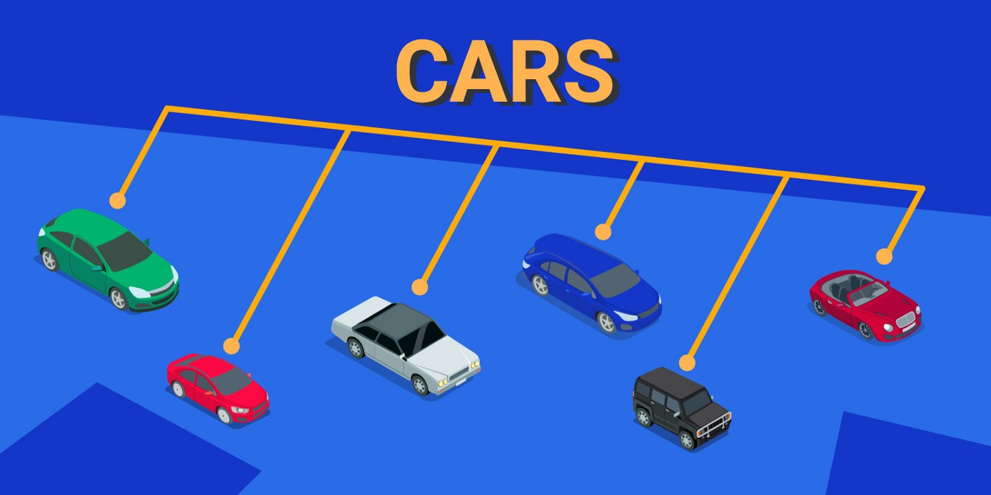
Approach
We implemented the solution by using an object-oriented approach
The user is initially asked for budget and group size. Additionally, they choose a state
This information is stored as objects in their distinct classes. We have made a major use of inheritance.
For example, rental car class is derived from car class which is derived from the superclass vehicle
The class Plane is derived from vehicle as well.
If we were not to use an object oriented Approach:
We would implement header files instead of using packages
Instead of using classes we would use structs
There would be no implementation of GUIS.

Slide 4
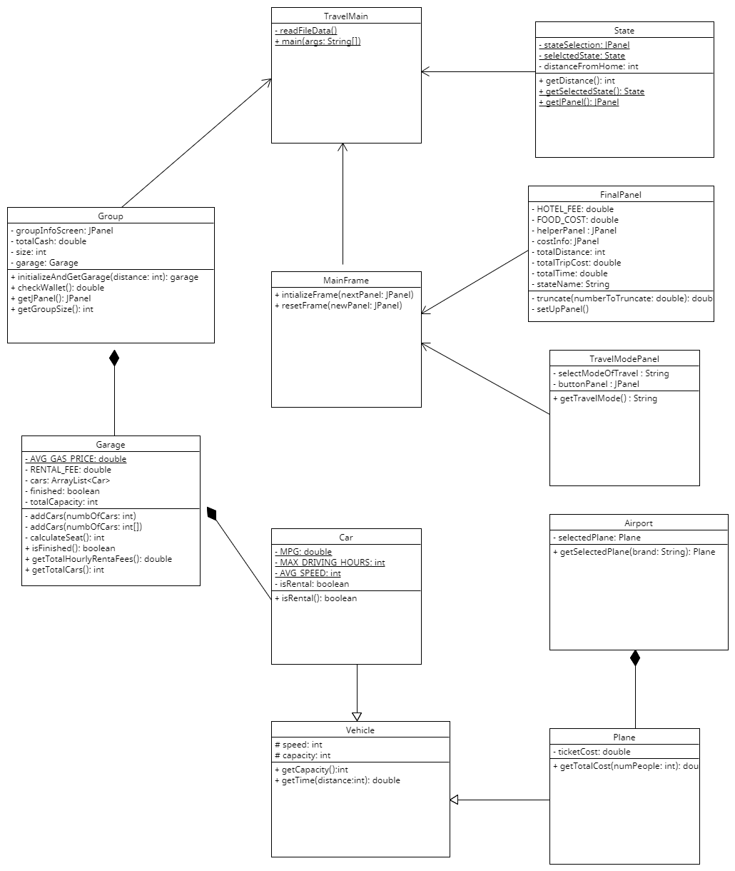
UML Diagram

Slide 5
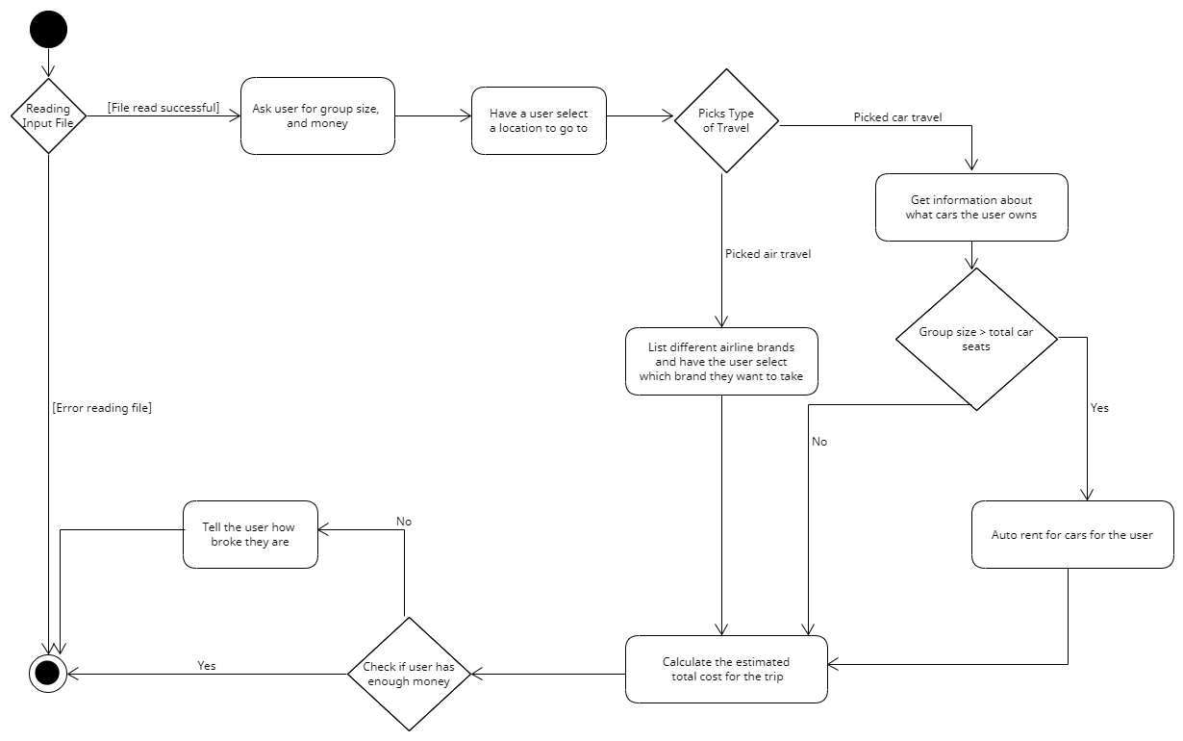
Activity Diagram

Slide 6
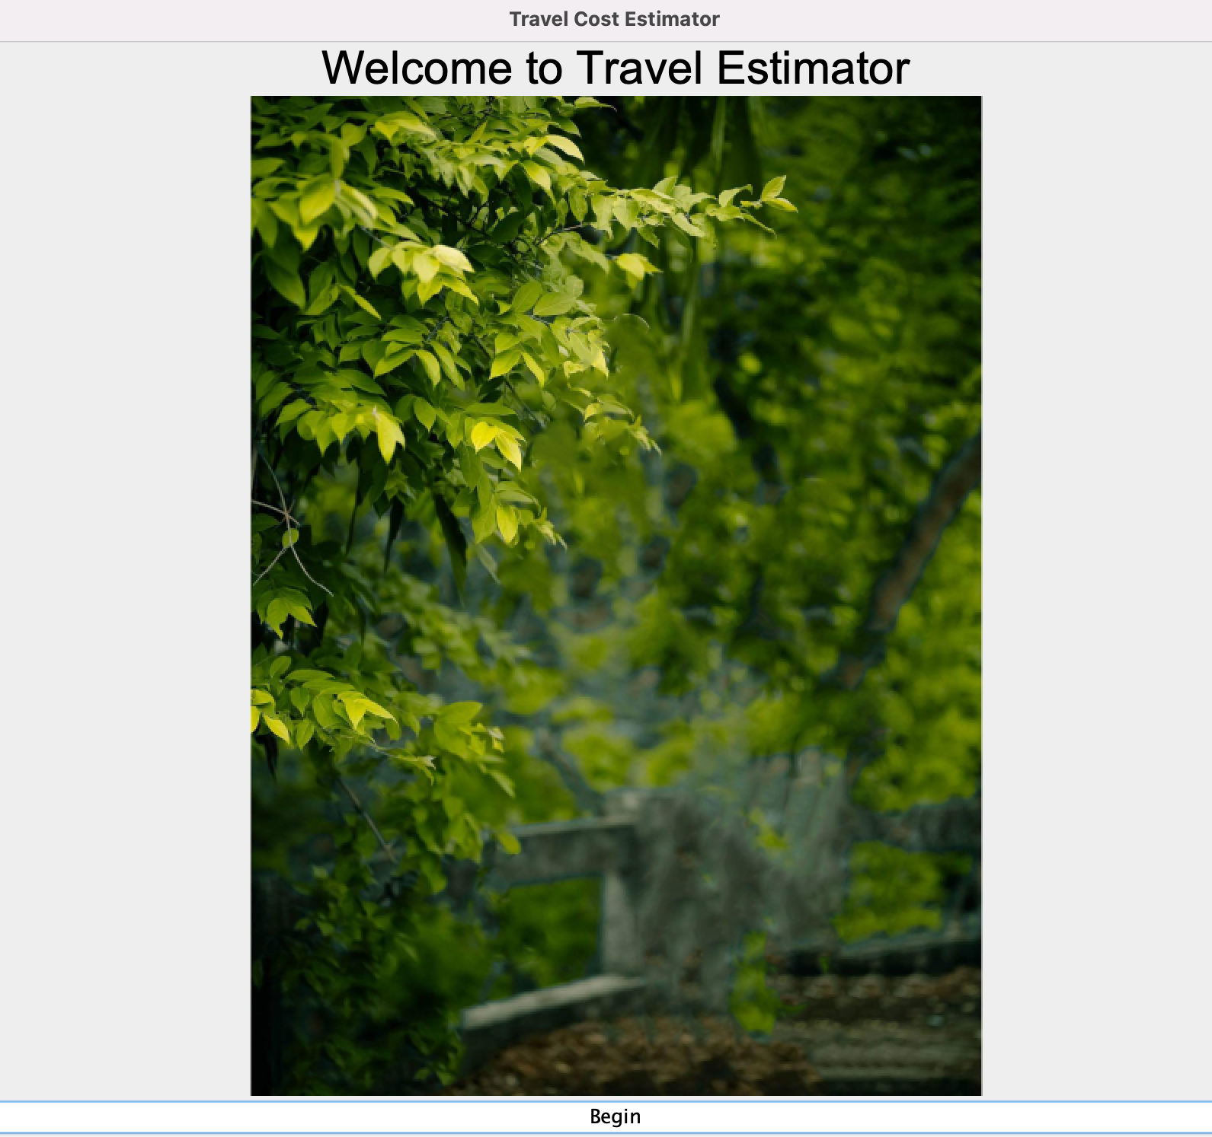
Program snapshots
Start of the Program
Main Gui Frame

Slide 7
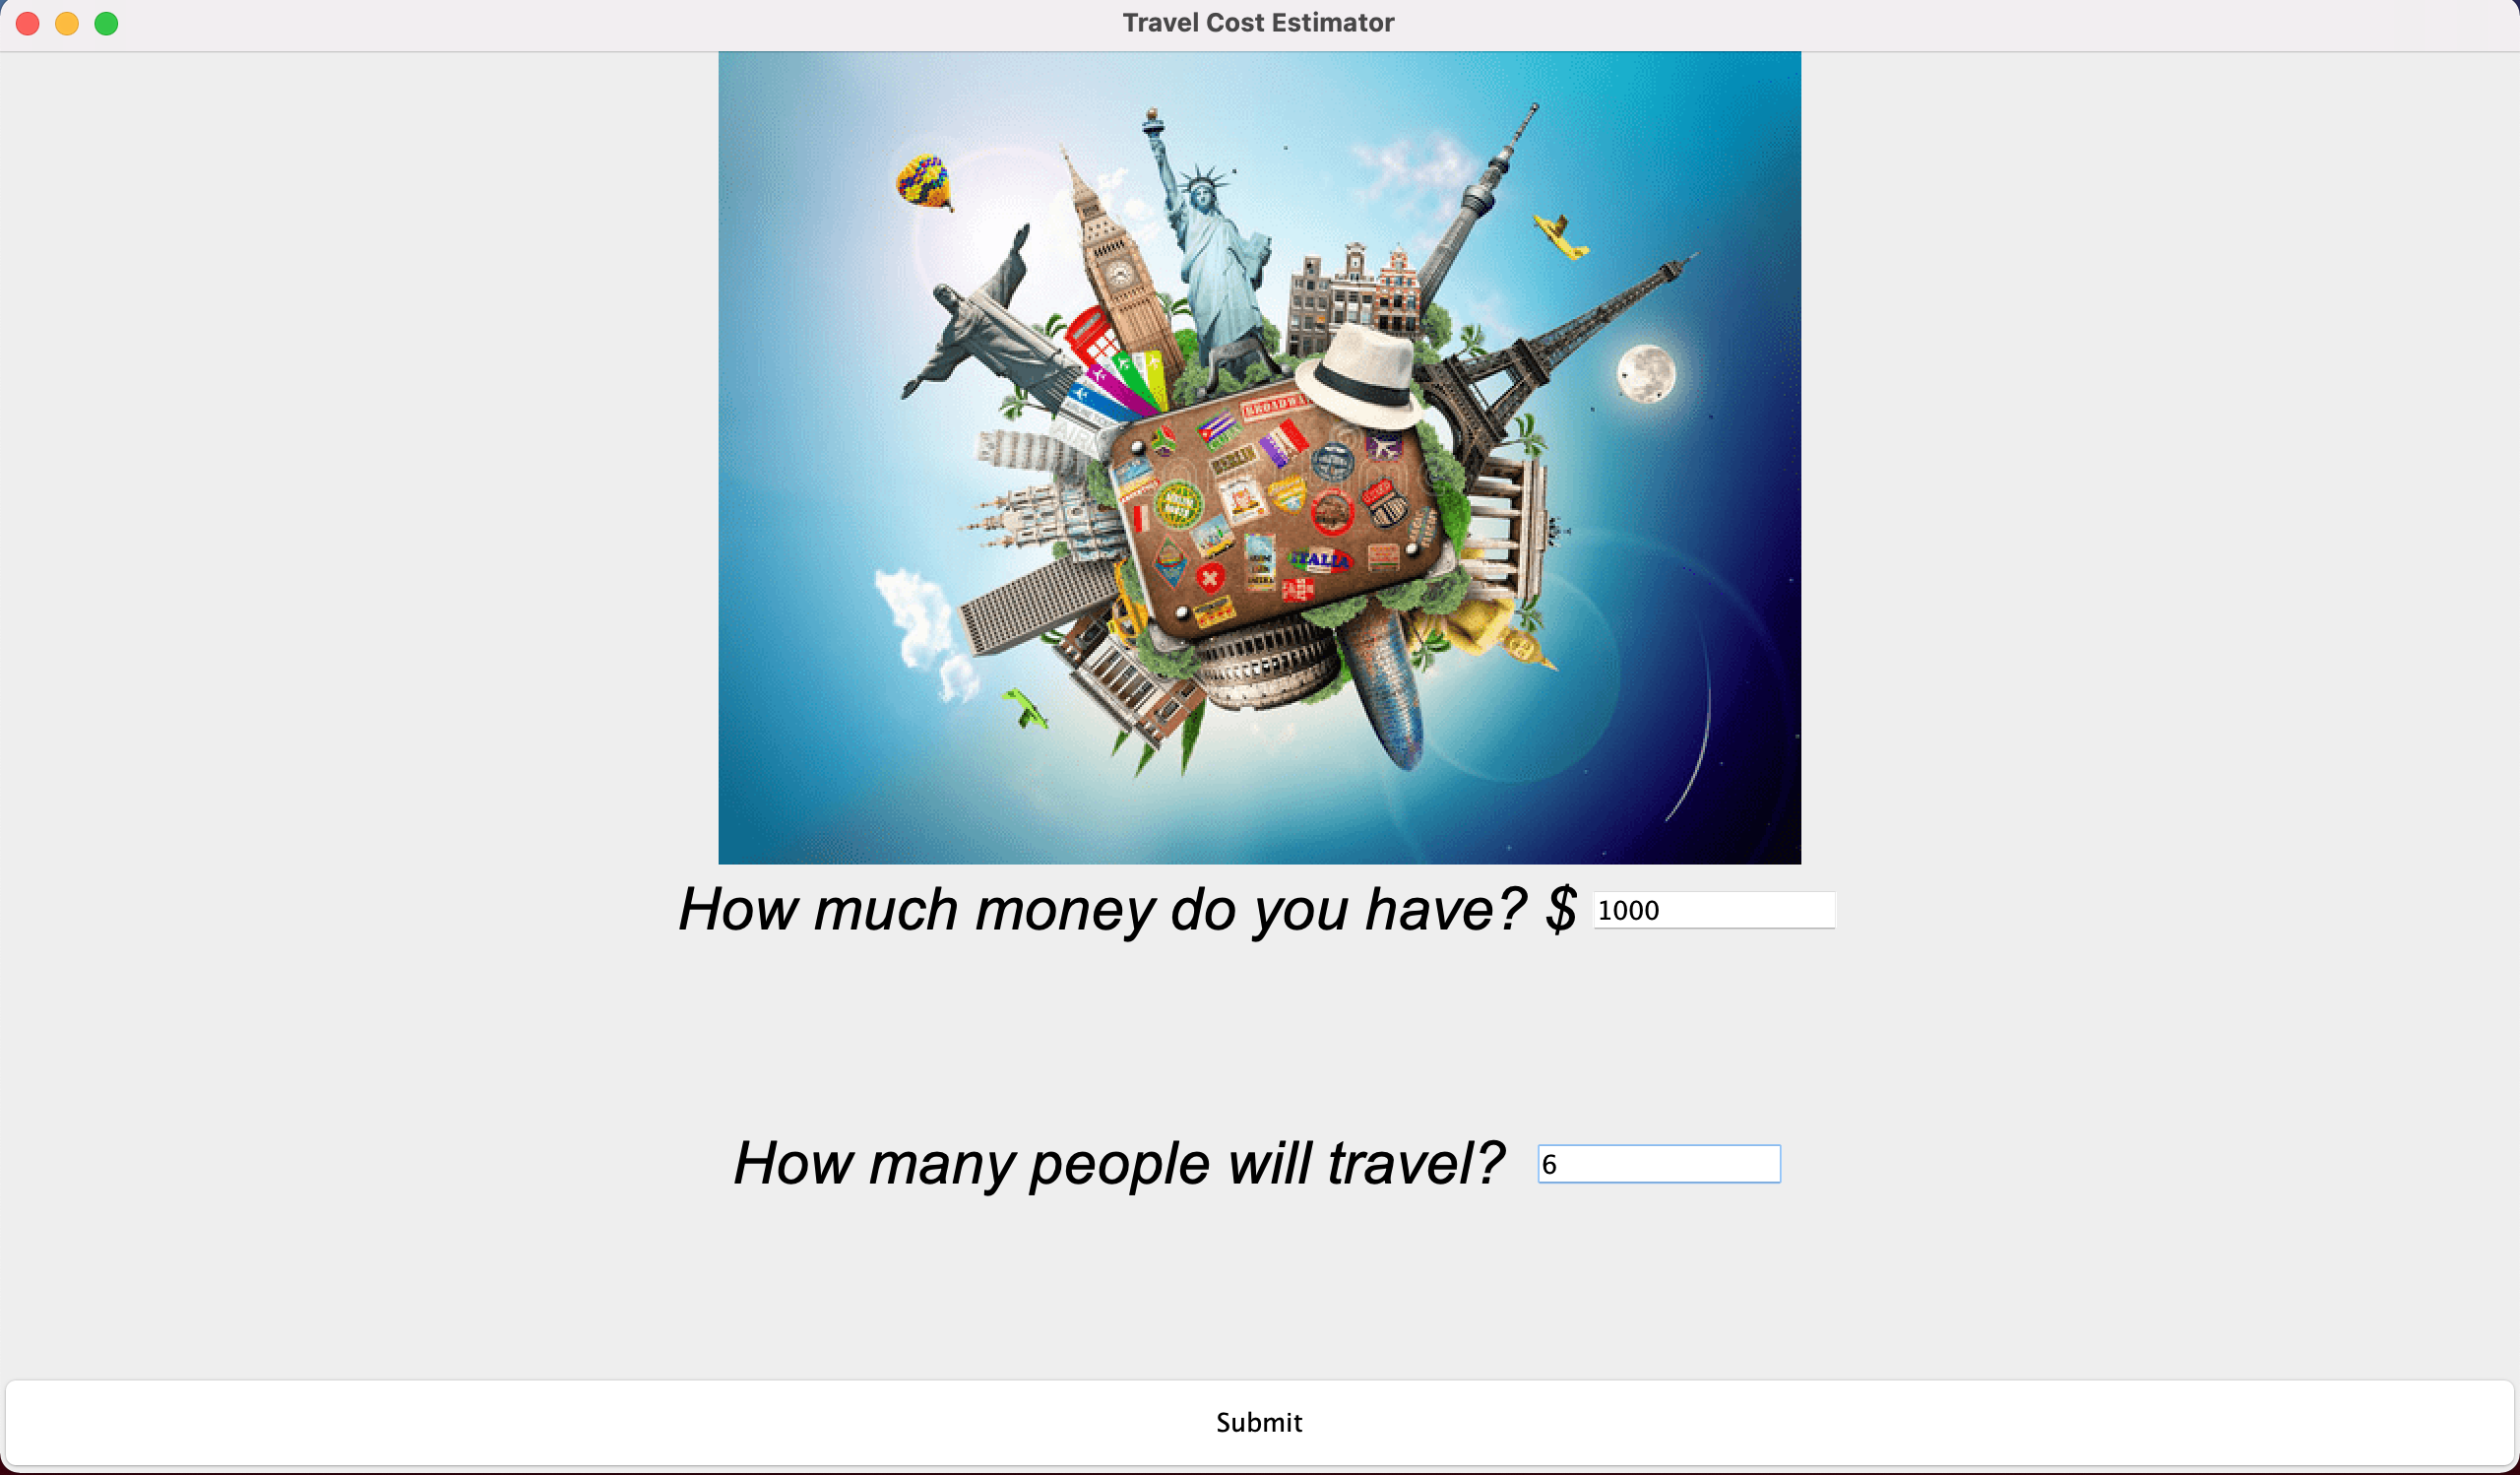
Entering info
Customer is prompted to enter their budget and the size of the group

Slide 8
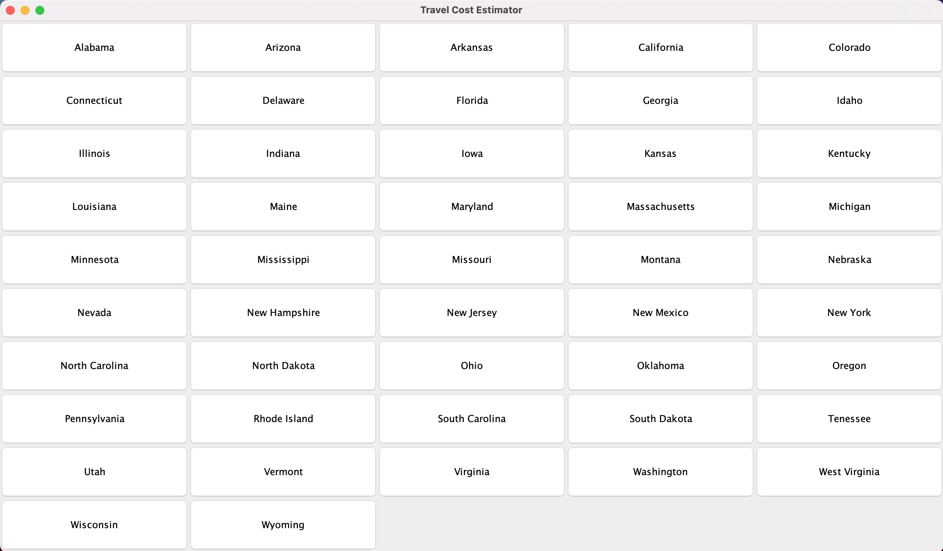
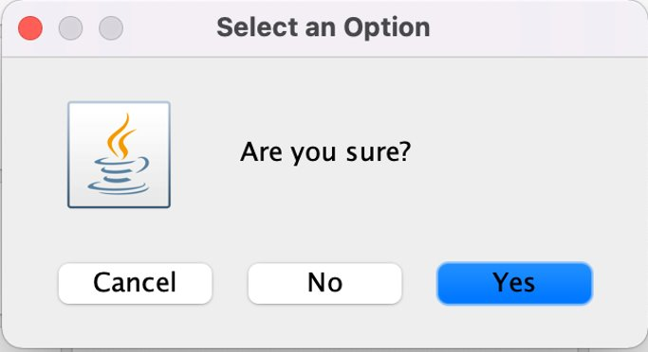
Select the destination
A frame appears where customer chooses the state.
A dialog box appears for their confirmation

Slide 9
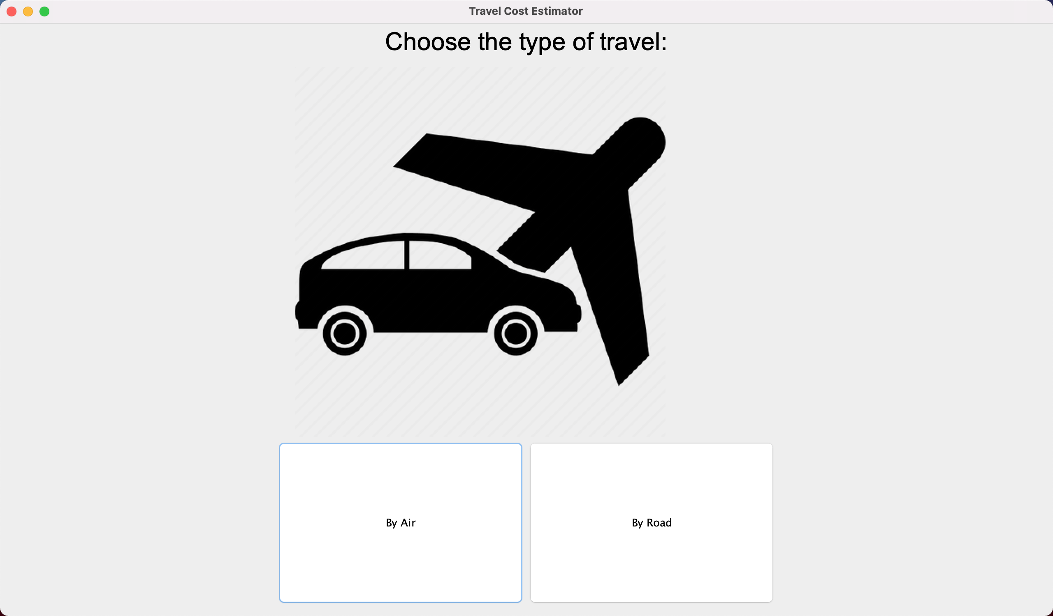
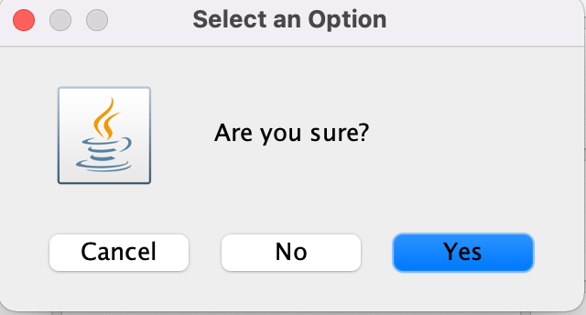
METHOD Of transport
Customer is given a choice between two modes of travel by air or by road
A dialog box appears for their confirmation

Slide 10
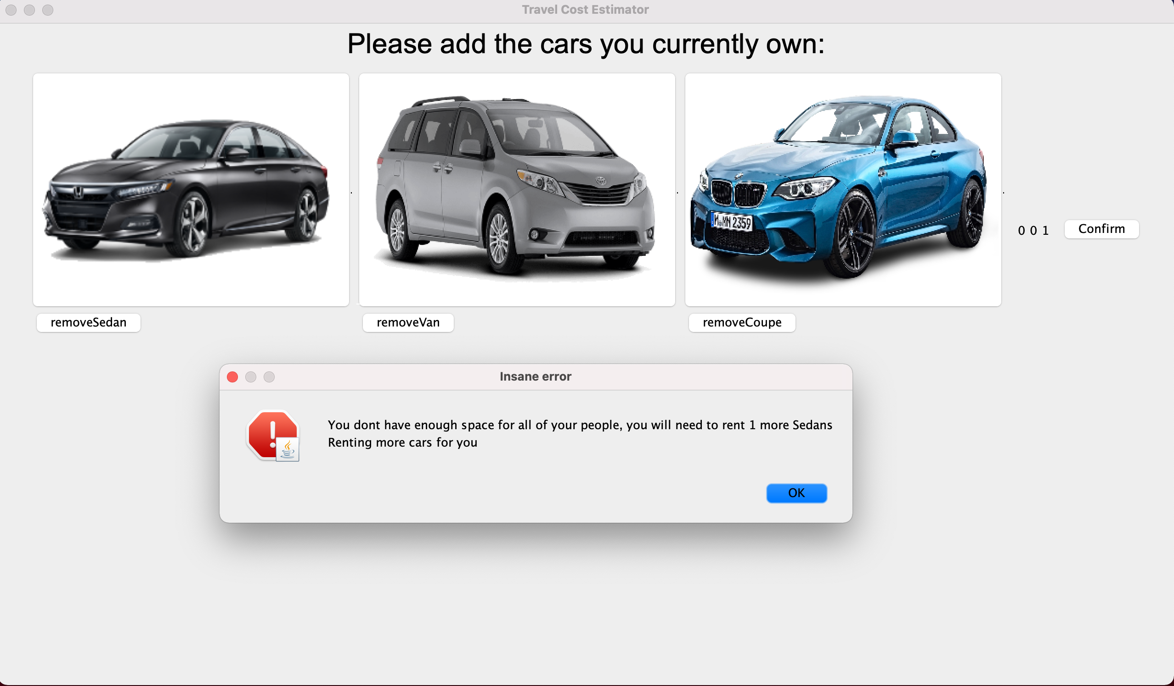
Personal Cars
The customer is prompted to enter information about the cars that they intend to use.
The customer has a group size exceeding the capacity of the chosen coupe.
A number of sedans are automatically rented for the customer to fit the requirements of the journey

Slide 11
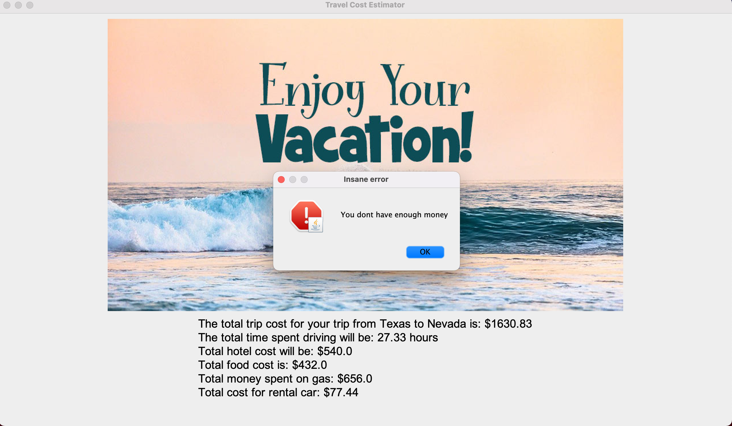
Travel Estimator
Trip information is displayed to the customer
An error appears showing the customer that they cannot afford to travel via this mean of transport

